Slide 1
Challenge Orientation (Phase 1)
Bertelsmann Technology Scholarship
December 7, 2020

Slide 2

CONGRATULATIONS! 🎉
We’re excited to welcome you to the Bertelsmann Technology Scholarship Program!

Slide 3

Program Overview
Getting Started
Accessing your Classroom
Course Advice
Slack Community
Community Resources
Community Initiatives
Alumni Scholarship Advice
Happy Hour!
TODAY’S
AGENDA

Slide 4
Program
Overview

Slide 5



How is the Scholarship Program structured?
Phase One
Foundations Course & Slack Community
The first phase of this Scholarship provides access to the Bertelsmann Technology Scholarship Foundations Course and our private Slack Community for the track you are accepted into.
Phase Two
1,600 Nanodegree Scholarships
The 1,600 top performers from Phase 1 will earn a scholarship to their respective Nanodegree Program.
The full-scholarships will include project reviews, mentor and community support.
Challenge Phase:
16,000 Students
1,600 Students
Predictive Analytics for Business Nanodegree
Developer for Microsoft Azure
Nanodegree
AI Product
Manager Nanodegree

Slide 6
How Do I Move On to Phase Two?
These 3 criteria will be used to determine entry into Phase 2:
1. 100% completion of all Foundations coursework and materials, by the March 15th deadline. This includes:
Lessons
Videos
Quizzes
No projects
2. Community Participation
Participation in Community events and support of your classmates in the Slack community
3. Selection Criteria used in Phase 1
Criteria that was used when you were selected for Phase 1

Slide 7
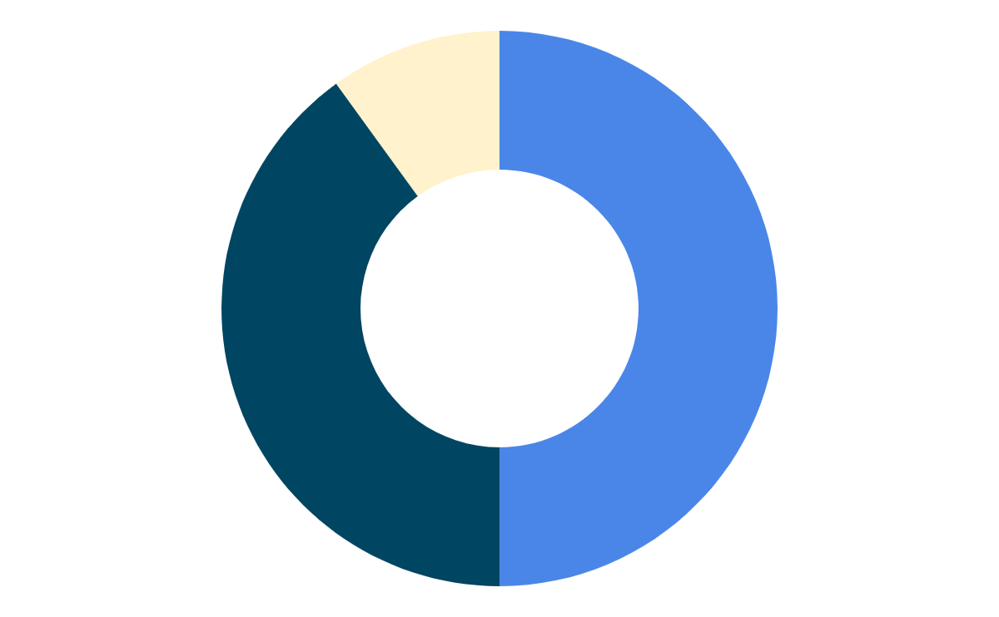
What qualifies as Community Participation?
Student Initiatives
Creating a new program, or event for the community that helps with Community Building or Course Completion.
Community Manager Organized Initiatives
Participating in activities & programs organized by your Scholarships Community Team. eg. 50 Days of Udacity
Full schedule on Google site
3
3
Slack Contributions
- Consistent presence
- Posts that add value to discussions
- Willingness to help & be supportive of your peers

Slide 8
How do I participate in the Community?
(In descending order of most weighted to least weighted)
1. Community Manager organized initiatives
Participating in activities & programs organized by your Scholarships Community Team
Examples: Student Story Challenge, 60 Days of Udacity
See full schedule on Google site
2. Slack presence
Consistent presence (weekly activity vs. 24/7 presence last days of program)
Comments that add value to conversation
Willingness to help and be supportive of your peers
3. Student initiatives
Creating a new program, challenge, or event for the community
Must be accessible by all students
Should help with community building or course completion
Examples: Weekly Quiz competition, Mentoring program, technical webinars

Slide 9

Important Things to Note
Community Participation:
Genuine & Meaningful Slack activity
‘QUALITY’ over ‘QUANTITY’
Hello posts won’t count
No spamming!
No excessive tagging!
No advantages to being ‘first’ in a thread
Activity outside Slack workspace is not monitored
Have an idea for an initiative of your own?
Post the details in the #general_discussions channel
See how it resonates with your classmates
Once you have a full fledged plan, submit it to the Community Managers through a form! Each track will have a separate form: AI / Data / Cloud

Slide 10

Important Things to Note
Foundations Course:
Course is accessible 24/7
Program deadline is 11:59 PM PDT on March 15, 2021
There is no indicator for course completion inside the classroom - we recommend a manual double check
Each question in a quiz must be attempted! There is no penalty for incorrect quiz answers
The project lessons must be viewed, but you will not submit a project as a part of this course. However, you can work on these projects on your own to further your skillset. The project included in each track is the first project of the Nanodegree in Phase 2.

Slide 11

Final Reminder...
Everyone will be notified via email of their Phase 2 decision within two weeks after the Challenge ends
You must fully complete the Foundations course AND show consistent community participation by March 15th at 11:59 PM PDT to be considered for one of the 1,600 Scholarship Nanodegree Program seats.
Don’t leave it all for the last day!

Slide 12
Getting
Started

Slide 13
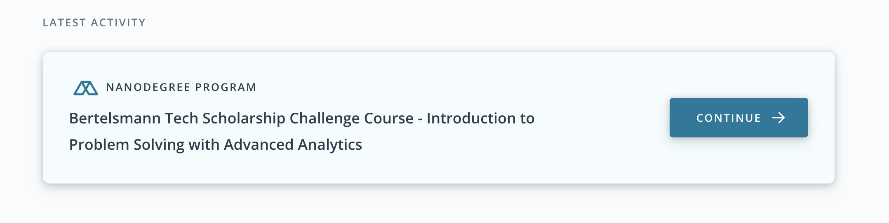
The Foundations course is now in your classroom!
Click on the Scholarship Foundations Course card to get started!
AI - Bertelsmann Scholarship - Introduction to AI in Business Nanodegree
Data - Bertelsmann Scholarship - Introduction to Problem Solving with Advanced Analytics
Cloud - Bertelsmann Scholarship - Introduction to Azure Application

Slide 14
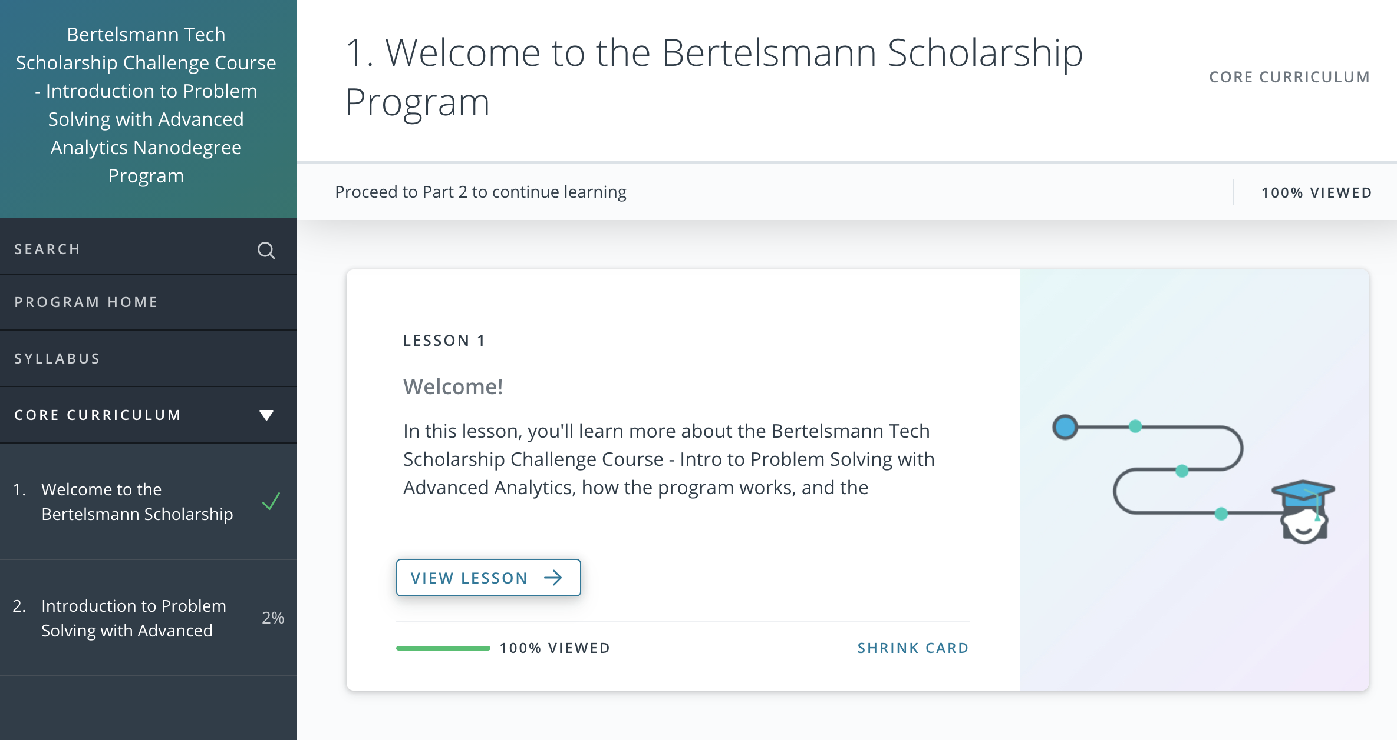
Once you’re inside the course, you can begin your journey with the first lesson then move onto the technical content for your respective track in the second module!

Slide 15

Spend at least 3-5 hours on the course each week
Consistent study sessions will help you retain information
Ask for help!
Lesson channels and #tech_help
Brush up on suggested prerequisites
Revisit concepts and skills to make sure you’re progressing through your Foundations course effectively
Tips from your Community Managers

Slide 16
Suggested Prerequisites
AI
Product management
Basic data analysis
Data
Basic statistics and math knowledge, including familiarity with descriptive and inferential statistics.
Basic algebra in order to understand the mathematical models that will be presented
Cloud
Python (1-3 years of programming experience preferred), with experience building Flask apps
SQL Server or MySQL to store and query data (you can get by with other SQL flavors as well)
Using Git to pull and push code

Slide 17
More on projects… no need to submit them!
There will be references to Nanodegree projects and some additional project materials provided. You will not submit a project as a part of this course.
The Foundations course is actually the first module of the Nanodegree program.
If you complete the project on your own, you’ll be ready to submit if you advance onto Phase 2.
Clicking “next” on the very project lesson page will take you to your classroom home page. This is expected behavior!

Slide 18
Slack
Community

Slide 19
Join the Slack Community
⚠️ You MUST join the Slack workspace and participate in the Slack community in order to be considered for Phase 2.
Find the invite link in your welcome email and the Welcome Lesson in your classroom
Meet and connect with classmates!
Get technical help from peers and Student Leaders
Receive support & motivation
Participate in community organized events and challenges to help you complete the course!
New to Slack?
Attend Slack Orientation on Wednesday, December 9th at 9AM PST!
Use our How to Use Slack page here.

Slide 20
& Community Guidelines
ONE: Respond in thread! We want to keep the whole convo together! Make sure to respond IN THREAD to the person you are replying too.
TWO: Use the Right Channel. Before you post, make sure you are posting your question or content in the correct channel
THREE: Be respectful of differing viewpoints and experiences. This is a space for learning and we want everyone to feel comfortable and welcome.
FOUR: Gracefully accept constructive criticism. We are here to grow and help one another! If someone has feedback about a project or idea, listen.
FIVE: Do what is best for the overall community. Make decisions that will impact the community positively! Find our Code of Conduct here

Slide 21

Stay active in the Slack Community & help your peers!
Read messages from Udacity staff posted in the #announcements channel
Follow the channels that you think are important to you. Don’t track every channel
Attend Slack Orientation and view our Slack Guide on the Google Site
Take part in Community Manager organized Initiatives
Find a Study Group or Study Partner!
How to be a successful student in Slack

Slide 22
Community
Resources

Slide 23
Your Classmates
Whether you’re connecting on Slack or in person, this scholarship student community will become essential in helping you complete this Challenge.
“To me personally more than the content of the program the thing I liked the most is the community support. The person who doesn't know you and they may be miles apart of different time zone but they were there to help you/motivate you in your difficult time as friend or a mentor. When you feel that you cannot complete this course but he/she thinks that you can do it. That is the best thing that is with this community.”

Slide 24


Student Leaders
Get help from your peers who have stepped up to be leaders in our public Technical and Non-technical channels
Every channel will have at least 3 Student Leaders - Use them for technical knowledge, guidance & support!
Student Leaders can be identified by this special Slack badge.

Slide 25
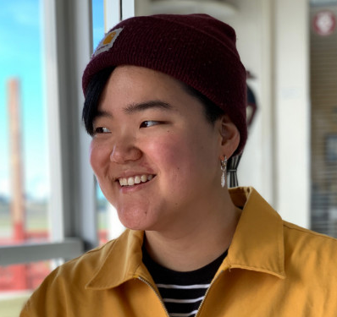

Scholarships Team
We’ve got your answers! 🛹 🐼
Attend 2x weekly AMA (Ask Me Anything Sessions in the #ama-session Slack channel for:
Non-technical program questions
Administrative questions
Submit a request to reach our Scholarship Support team for:
Account questions
Start a Group DM (Direct Message) with both Grace and Palak for:
Urgent issues that are personal in nature
Grace Cho
@Grace.Udacity
Palak Sadani
@Palak.Udacity
💡 Tip: Please @mention the both of us to ensure your question gets answered. For DMs, start a group DM with the two of us!

Slide 26

Bertelsmann Technology Google Site
The Bertelsmann Technology Challenge Google site is your go-to spot for information on this Scholarship program. Check back often as updates are made regularly. If you have a question, the answer is most likely here!
https://bit.ly/bertelsmann-scholar
🔖 Bookmark this site! ☝️

Slide 27

What you’ll find...
Extensive FAQs
Community Initiatives
Archived Slack Announcements
Calendar of Events
Important Forms and Links
Resources
Take your time to go through the site and become familiar with where to go when you need information!

Slide 28
Community
Initiatives

Slide 29

60 Days of Udacity
What it is: Our 60 Days of Udacity Challenge reinforces learnings by making studying a consistent habit.
What’s involved:
You’ll take a public pledge to code for 60 consecutive days
Posting a daily update in a dedicated Slack channel
Encouraging 2 others every day 🌈💖
“[This] challenge was very helpful in keeping track. It has helped me to form and maintain the habit of daily studying of technology and coding courses. This has stayed with me even after the course completion”
-- Maham A.

Slide 30
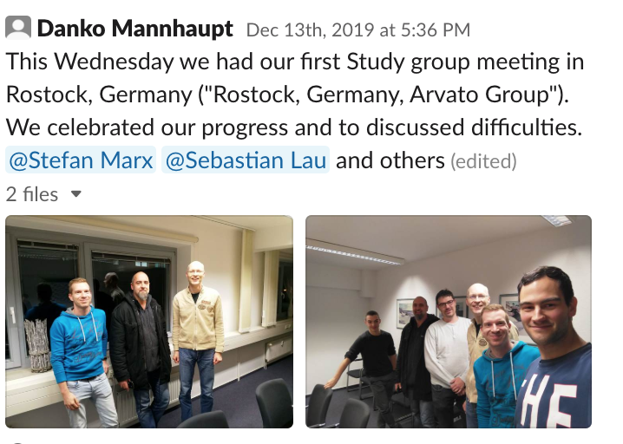
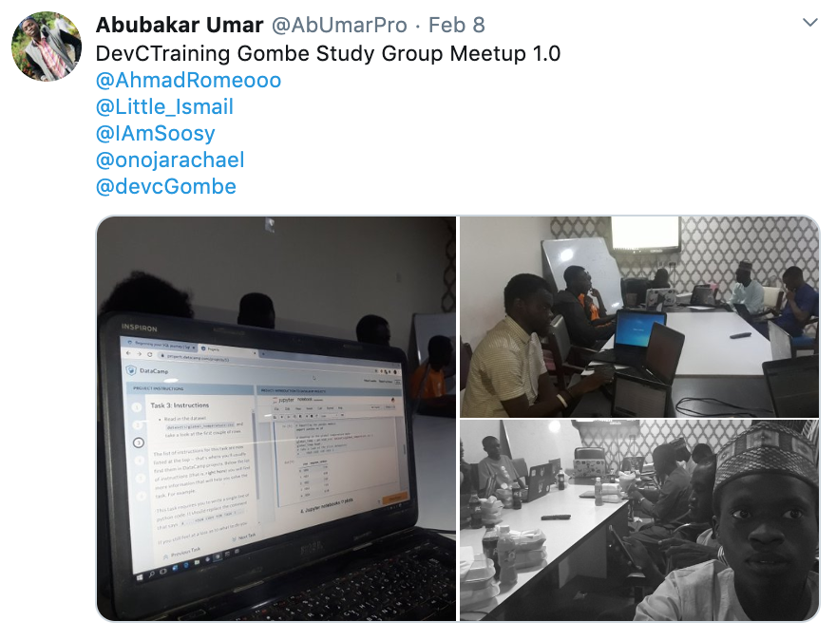
Study Groups
What it is: A great way to build deeper connections with your peers and gain the additional support you may need to complete the Foundations course.
Study Groups can be formed based on location, interests, or common goals.
Study Group activities may include:
Local and Virtual Meetups
Collaborative projects
Mini hackathons
Quiz competitions

Slide 31
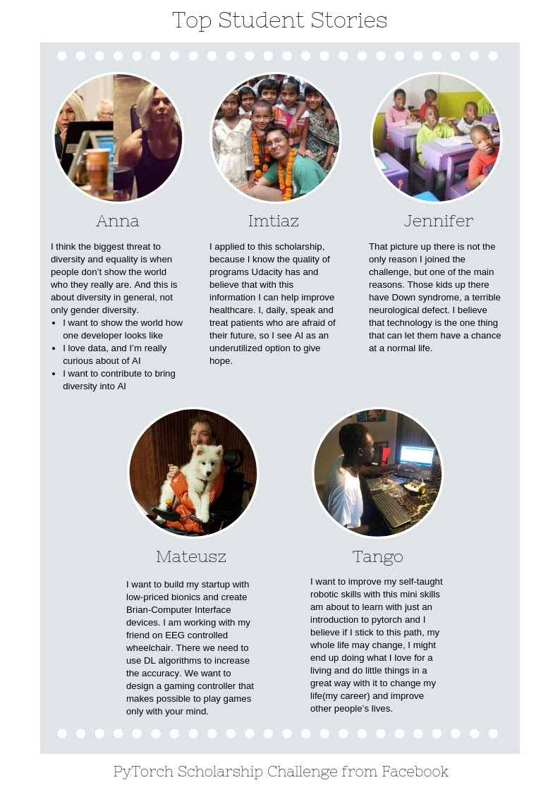
Student Story Challenge
What it is: Our most inspiring Challenge where we’ll ask you to share your personal story on what brought you to Udacity. Finalists have a chance at being featured on the Udacity blog.
We want to know:
What do you want the world to know about you!
Why did you apply for this Scholarship?
How will you use the knowledge you gain from this program?

Slide 32
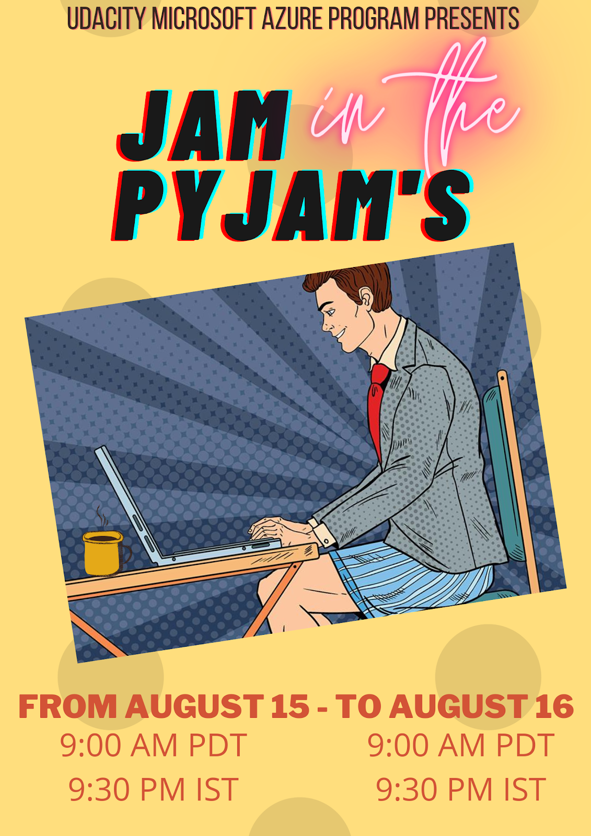
Study Jam
What it is: A marathon study session where everyone together towards the common goal of course completion.
Study Jams are organized by Student Leaders and student volunteers with guidance from the Community team.
Study Jam activities include:
Continuous live help in Slack
Technical & non-technical webinars
Technical AMAs
Icebreaker sessions

Slide 33
Timeline of Organized Events
Week 1 - Week of 12/7
Orientation
Introductory AMAs
Student Leader Program launches*
60 Days of Udacity*
Week 2 - Week of 12/14
Study Groups launch*
Bi-weekly AMAs begin
Week 3 - Week of 12/21
Study Smarts Week
Week 5 - Week of 1/4
[NEW] Community Program*
Week 6 - Week of 1/11
Student Story Challenge*
Midpoint Survey
Week 7 - Week of 1/18
Study Jam!*
Week 8 - Week of 1/15
Mentor/Mentee Program*
Week 14 - Week of 3/8
End of Program Survey*
Reverse AMA
End of Program Party!* 🎉
* These programs organized by Community Manager will formally count towards community participation

Slide 34
Scholarship Alumni Advice

Slide 35
Tips and Tricks
alias the “survival kit”

Slide 36
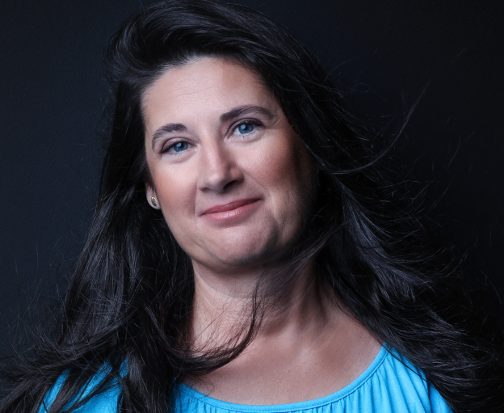
As a way of introduction….
Magdi Gunther-Nyeso
Consultant with 20 years experience in financial services (specialized for the media industry)
MA in International Relationship (Foreign Affairs), BSc in Tourism and Hotel Management (+ European Studies)
Bertelsmann Technology Scholarship winner
Data Analyst Nanodegree - Udacity
Passionate motivator and feel good facilitator

Slide 37
Community participation
Main communication tool: Slack
Use common sense: don’t spam / pollute the thread of conversation
Make a post to create value, to share your opinion and relevant information, to ask and answer questions
Mind the code of conduct
Attend the weekly AMA sessions
Be (pro)active in the chosen study group
Teamwork over competition
Diversity and equality

Slide 38
Learning path
Support your peers and seek help if needed
Make a study plan and stick to it
Choose an accountability peer
Cover all the quizzes
Search for additional materials, videos for the sake of clarity and for deepening your knowledge
Keep on learning and practicing

Slide 39

The extra mile
Be creative in terms of initiatives
Set your priorities
Keep the balance through unwinding
Pay attention to your well-being
Challenge yourself: stretch your boundaries
Remember why you are here
Make connections
Have fun!

Slide 40
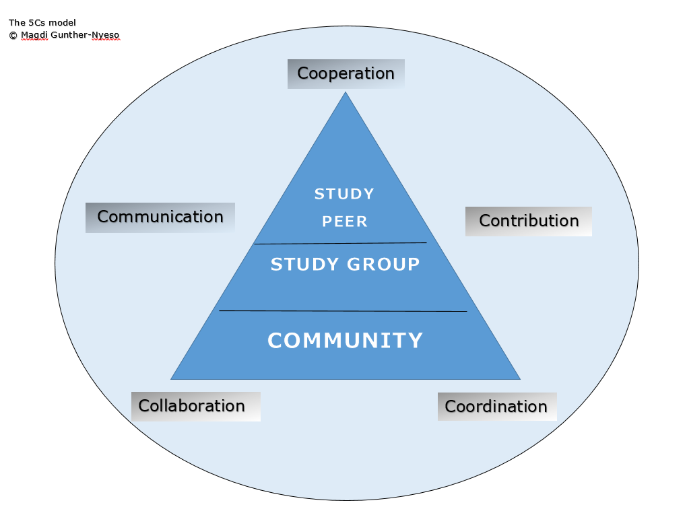

Slide 41

© Abbie Weisenbloom (Cloud track)

Slide 42
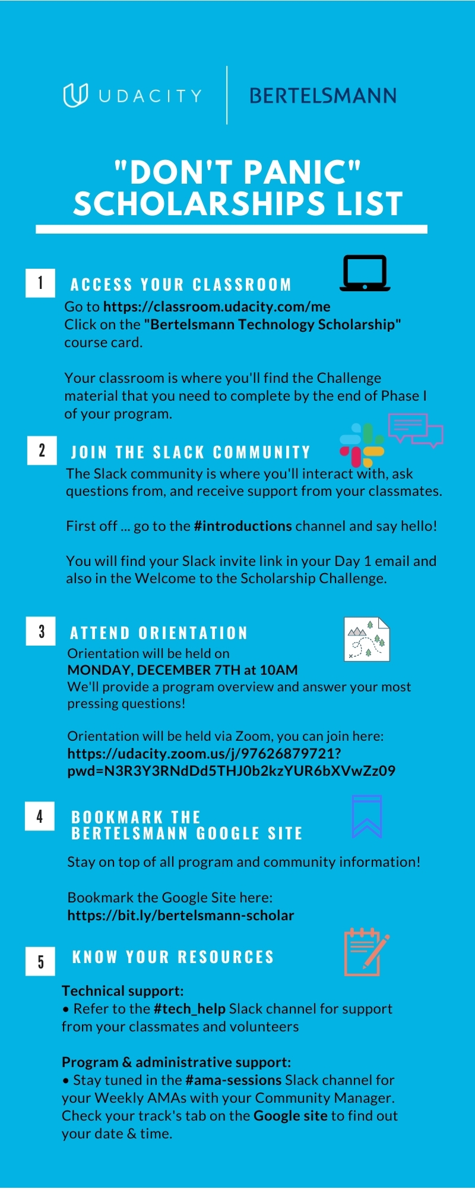
D
O
N’
T
P
A
N
I
C
L
I
S
T
5 Easy Steps to Getting Started
Access Your Classroom
Join the Slack Community
Attend Orientation
Bookmark the Bertelsmann Technology Google Site
Know Your Resources
Print the “Don’t Panic” sheet here.

Slide 43
Wrapping up…
When does the Challenge phase end?
The deadline for completing your Challenge course is March 15, 2021
Do I need to complete all the coursework?
Yes. You will need to complete the coursework by March 15, 2021 to be considered for Phase 2.
Do I have to participate in the Community in Phase 1?
Community participation is required in Phase 1 as it is one of the selection criteria for Phase 2. While your #1 priority should be progressing through and completing your coursework. We recommend you engage with your peers, since we have seen time and again that the most successful students are those who learn in community. Best of luck!

Slide 44
Wrapping up…
Will I receive a certificate of completion?
No, but we will provide instructions on how to highlight your Scholarship experience on LinkedIn once Phase 1 ends.
Will I be able to access the course past March 15, 2021?
No, all students will be unenrolled from their Foundations course once the deadline has passed.
Will the Foundations course be turned into a free course?
No, the Foundations courses are the preliminary lessons of the Nanodegree program and cannot be accessed for free.

Slide 45
Live Q&A

Slide 46
Happy Hour Time!*
Join us in the #introductions channel in Slack to meet your new classmates, answer fun ice-breaker questions, and relax a little!
*No alcohol required!!!
Q&A…

Slide 47
Additional Questions? Come to the next AMA! (Ask Me Anything)
AMAs are hour-long question and answer sessions that are conducted in #ama_sessions every week! Come ask your Community Managers any non-technical questions related to the Scholarship program 👋
🗓 Next AMAs:
AI: Tuesday, December 8th @ 9AM PST
Data: Tuesday, December 8th @ 10AM PST
Cloud: Monday, December 7th @ 8PM PST

Slide 48
Thank you!
Please refer to the FAQ section on our Bertelsmann Technology Google site or attend a Community Manager AMA (Ask Me Anything) session if you have any questions on the material presented.

